Slide 1
Places to Visit in India

Slide 2
Delhi – The Capital of India

Slide 3
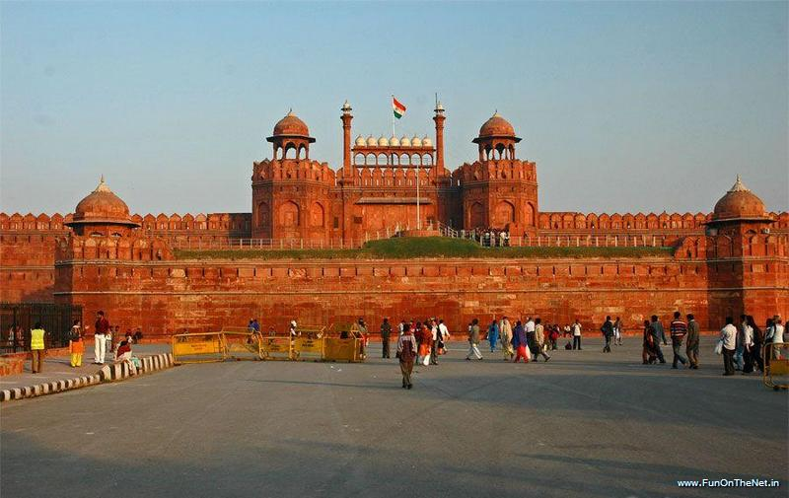
Red Fort
Red Fort or Lal Quila (Son-et-lumiere show) -- The mughal emperor, Shah Jahan, after ruling from Agra for eleven years, decided to shift to Delhi and laid the foundation stone of the Red Fort in 1618. It is called so because of the red stone with which it is built, the Red Fort is one of the most magnificent palaces in the world. India's history is also closely linked with this fort. It was from here that the British deposed the last Mughal ruler, Bahadur Shah Zafar, marking the end of the three century long Mughal rule. It was also from its ramparts that the first Prime Minister of India, pundit Jawaharlal Nehru, announced to the nation that India was free from colonial rule. Daily sound and light shows are held here in Both Hindi & English.

Slide 4
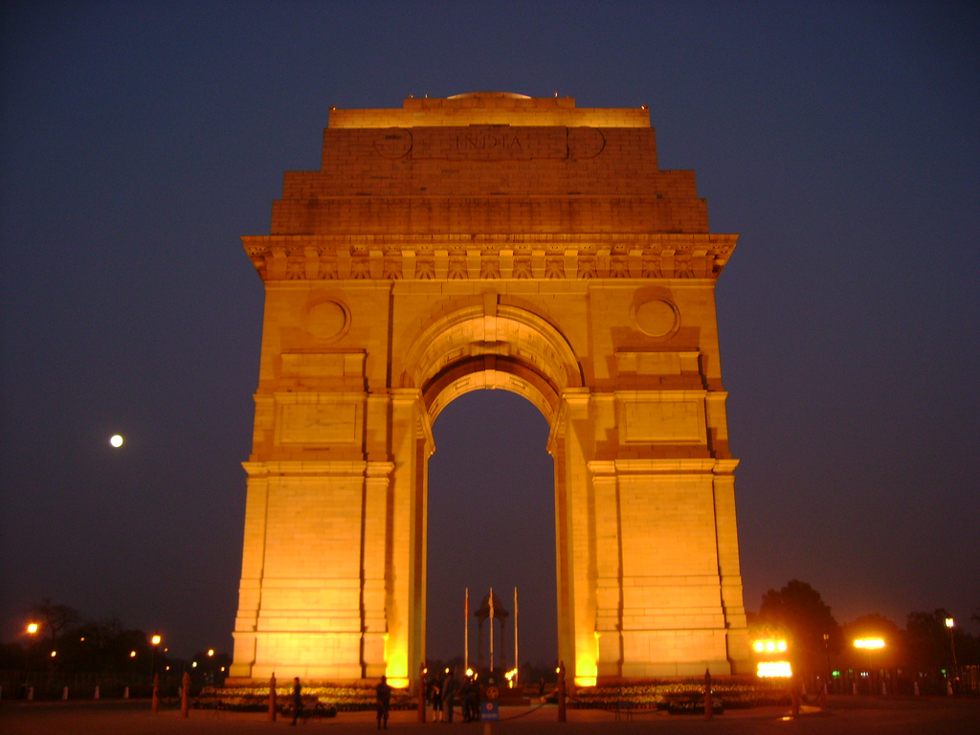
India Gate
India Gate -- Built as a memorial to commemorate the 70,000 India soldiers killed in World War I, India Gate was designed by Sir Edwin Lutyens and completed in 1931. Located on Rajpath, the road that leads to the magnificent Rashtrapati Bhawan, the gate is 160 feet high with an arch of 138 feet. Built from sandstone, the arch also houses the Eternal Flame, a gesture in memory of the Indian soldiers who laid their lives in the 1971 war with Pakistan.

Slide 5
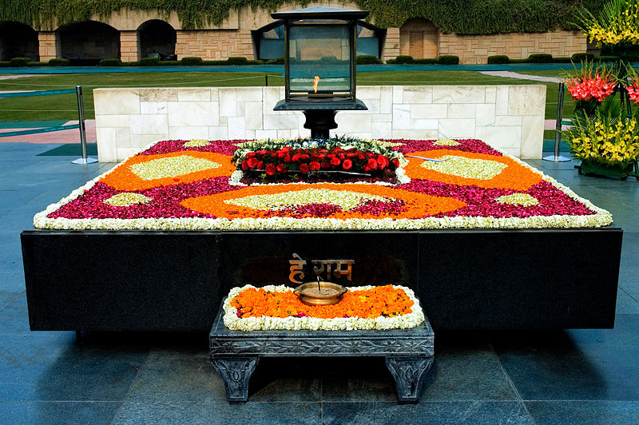
Raj Ghat – Memorial for Mahatma Gandhi
Raj Ghat -- The mortal remains of Mahatma Gandhi were cremated on this spot on the west bank of the river Yamuna on the evening of January 31, 1948. A simple open platform inscribed with the Mahatma's last words, 'Hey Ram' (Oh God) is set in a garden with fountains and a variety of exotic trees.

Slide 6
Uttar Pradesh

Slide 7
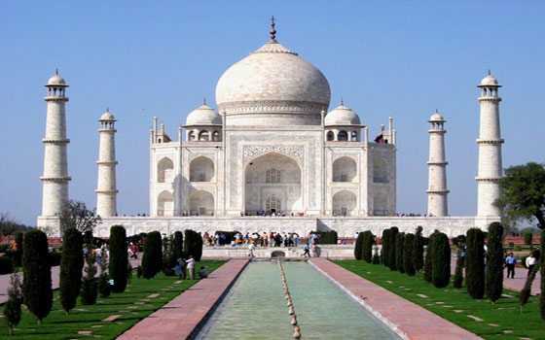
Taj Mahal (in Agra)
Taj Mahal is built in marble. The Taj Mahal, is the one and only one of its kind across the world. The monumental labour of love of a great ruler for his beloved queen. The ultimate realisation of Emperor Shah Jehan's dream. From 1631 A.D., it took 22 years in the making. An estimated 20,000 people worked to complete the enchanting mausoleum, on the banks of the Yamuna.

Slide 8
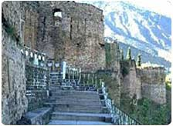
Ram Kot (in Ayodhya)
Ramkot - The chief place of worship in Ayodhya is the site of the ancient citadel of Ramkot, which stands on an elevated ground in the western part of the city. Although visited by pilgrims throughout the year, this sacred place attracts devotees from all over India and abroad, on `Ram Navami', the day of Lord's birth, which is celebrated with great pomp and show, in the Hindu month of Chaitra (March-April).

Slide 9
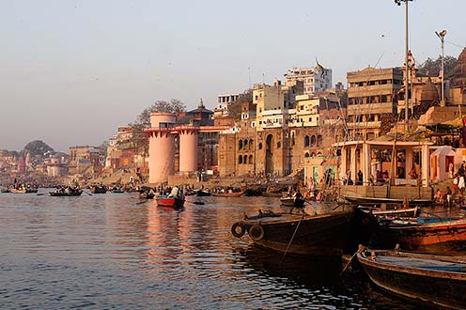
River Front-Ghat (in Varanasi)
River Front (Ghats) - The great river banks at Varanasi, built high with eighteenth and nineteenth-century pavilions and palaces, temples and terraces, are lined with an endless chain of stone steps - the ghats - progressing along the whole of the waterfront, altering in appearance with the dramatic seasonal fluctuations of the river level. Each of the hundred ghats, big and small, is marked by a lingam, and occupies its own special place in the religious geography of the city. Some have crumbled over the years; others continue to thrive, with early-morning bathers, brahmin priests offering puja, and people practicing meditation and yoga. Hindus regard the Ganges as amrita, the elixir of life, which brings purity to the living and salvation to the dead; For centuries, pilgrims have traced the perimeter of the city by a ritual circumambulation, paying homage to shrines on the way. Among the most popular routes is the Panchatirthi Yatra, which takes in the Pancha, (five) Trithi (crossing) of Asi, Dashashwamedha, Adi Keshava, Panchganga and finally Manikarnika.

Slide 10
Gujarat

Slide 11
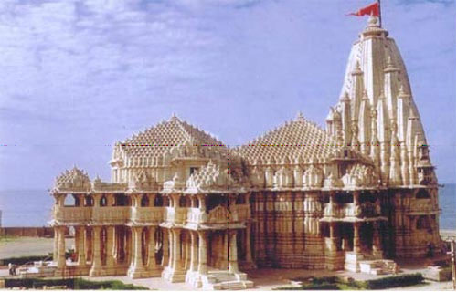
Dwarkadhish Temple - Dwaraka
The Dwarakadheesh temple is a Hindu temple dedicated to Lord Krishna, who is worshipped here by the name Dwarkadhish, or 'King of Dwarka'. It is situated at Dwarka, Gujarat, which is believed to have been built after the historic Dvarka city, the Kingdom of Krishna himself which submerged in to the ocean after the Mahabharata war.

Slide 12
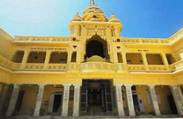
Kirti Mandir- Porbandar
Kirti Mandir - Built within the precincts of an old house where Mahatma Gandhi was born and dedicated to him.

Slide 13
Maharashtra

Slide 14
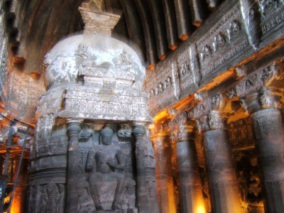
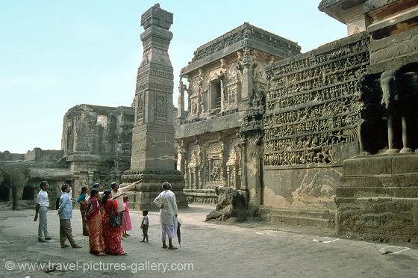
Ajanta and Ellora Caves (in Aurangabad)
Ellora Caves: The Ellora Caves belong to the Buddhist, Hindu and Jain faiths. There are in all 34 caves, of which 12 are Buddhist, 17 Hindu and 5 Jain. The most remarkable of the carved shrines at Ellora is the Kailasa Temple chiseled out from a single rock & is lavishly carved and sculpted.
Ajanta Caves: The thirty rock-hewn caves at Ajanta, cut into the scarp of a cliff are either Chaityas (chapels) or Viharas (monasteries). On the walls of the caves are paintings, many still glowing with their original colours. The outer walls are covered with brilliantly executed sculpture. The Buddhist theme of the Ajanta paintings recounts the life of Lord Buddha and tales of his previous earthly experiences.

Slide 15
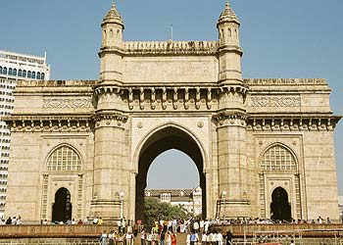
Gateway of India (in Mumbai)
The Gateway of India is a monument in Mumbai (formerly Bombay), India. Located on the waterfront in Apollo Bunder area in South Mumbai, the Gateway is a basalt arch 26 metres (85 ft) high. It was a crude jetty used by fisher folks and was later renovated and used as a landing place for British governors and other distinguished personages. In earlier times, the Gateway was the monument that visitors arriving by boat would have first seen in the city of Mumbai.

Slide 16
Punjab

Slide 17
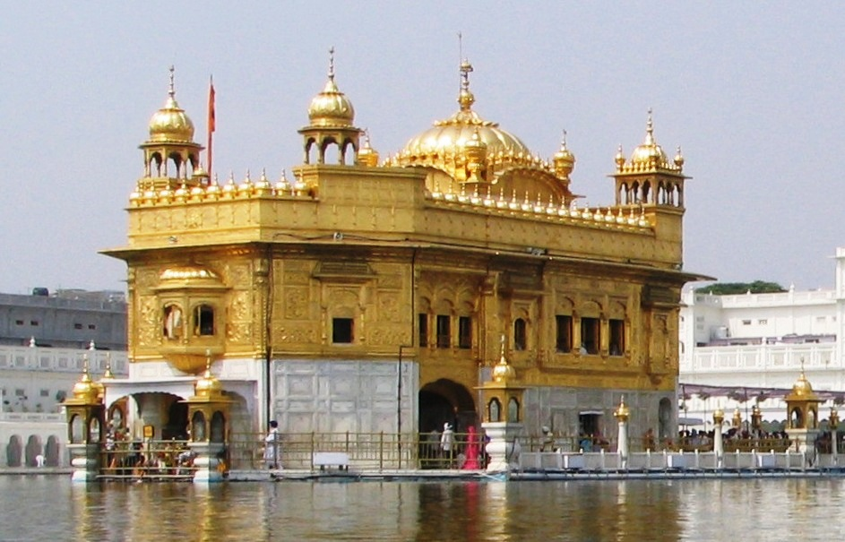
Golden Temple (Amritsar)
The Harmandir also Darbar Sahib informally referred to as The Golden Temple,[is a prominent Sikh gurdwara located in the city of Amritsar, Punjab (India). Construction of the gurdwara was begun by Guru Ram Das, the fourth Sikh Guru, and completed by his successor, Guru Arjan. In 1604, Guru Arjan completed the Adi Granth, the holy scripture of Sikhism, and installed it in the Gurdwara. In 1634, Guru Hargobind left Amritsar for the Sivalik Hills and for the remainder of the seventeenth century the city and gurdwara was in the hands of forces hostile to the Sikh Gurus.[During the eighteenth century, the Harmandir Sahib was the site of frequent fighting between the Sikhs on one side and either Mughal or Afghan forces on the other side and the gurdwara occasionally suffered damage. In the early nineteenth century, Maharaja Ranjit Singh secured the Punjab region from outside attack and covered the upper floors of the gurdwara with gold, which gives it its distinctive appearance and english name of "Golden Temple".[

Slide 18
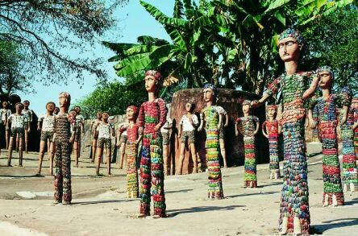
Rock Garden- Chandigarh
Rock Garden -- The Rock Garden of Chandigarh has been created by putting together the fossils of ancient life forms found in the Shivalik hills and by recycled waste material. Its creator, Nek Chand, was an inspector in the engineering department. Rock fossils have been arranged into an open air sculpture exhibition. Some of the sculptures include a wall made out of discarded fluorescent tubes, an army of clay monkeys and broken chinaware soldiers and shapes of women made out of discarded glass bangles. The garden covers an area of 6 acres.

Slide 19
Rajasthan

Slide 20
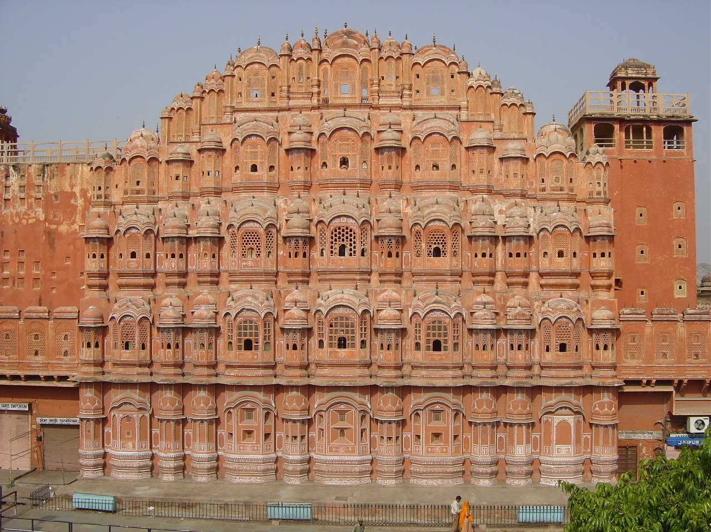
Hawa Mahal (in Jaipur)
Hawa Mahal - The ornamental facade of this "Palace of Winds" is a prominent landmark in Jaipur. Their five-storey structures of sandstone plastered pink encrusted with fine trelliswork and elaborate balconies. The palace has 953 niches and windows. Built in 1799 by Pratap Singh, the Mahal was a royal grandstand for the palace women.

Slide 21
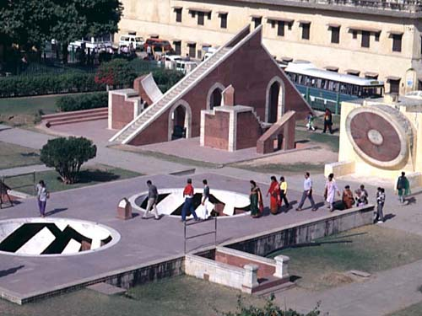
Jantar Mantar (in Jaipur)
Jantar Mantar - This is the largest and the best preserved of the five observatories built by Jai Singh II in different parts of the country. This observatory consisting of outsized astronomical instruments is still in use. .

Slide 22
Jammu and Kashmir

Slide 23
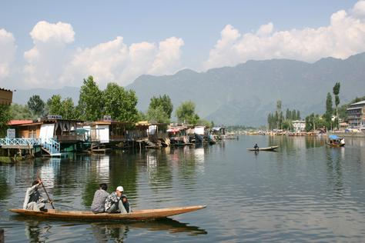
Dal lake (in Srinagar)
Srinagar's distinctive feature is the great body of water, the Dal Lake, which forms its focal point. The Dal has, within its area, two enormous sheet-like expanses of water-Lokut-dal and Bod-dal, the rest of its surface being broken up alternatively by man-made strips of land inhabited by whole colonies of people and vegetation. Thus the lake is not a flat, unbroken mass of water, but a labyrinth of waterways, awash with a lifestyle not found elsewhere in the world.

Slide 24
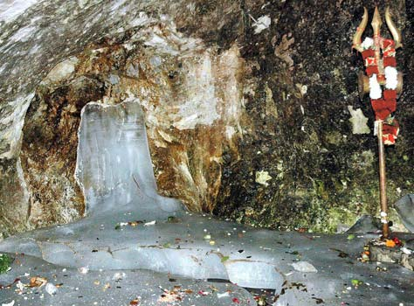
Amarnath Yatra – Lord Shiva Temple
Situated at a height of 3,880 metres in the Himalayas, the cave enshrines a naturally formed ice-lingam, symbol of Lord Shiva, which waxes and wanes with the moon, reaching its maximum dimensions on the day of pilgrimage. This is where, Hindus believe, Lord Shiva explained the secret of salvation to his consort Parvati on a full moon night. Every year in the month of Shravana (July-August), when the moon is full, thousands of devout pilgrims gather before Amarnath Cave in the picturesque Lidder Valley in Kashmir to offer their prayers to Lord Shiva.

Slide 25
West Bengal

Slide 26
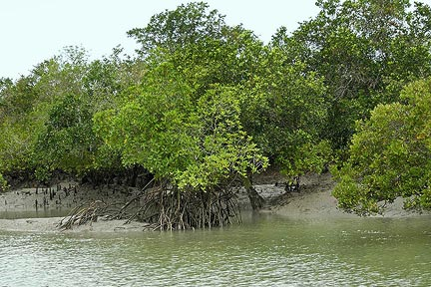
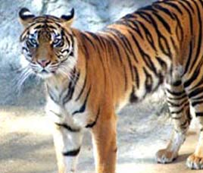
Sunderbans
Situated on the lower end of the Gangetic West Bengal, 22.00° N - 89.00° E, is this world's largest delta covered by mangrove forest and vast saline mud flats. A land of 54 tiny islands, crisscrossed by innumerable tributaries of Ganga, that was once infested by Arakanese and Portuguese pirates is now the abode of varied flora & fauna population. An area of 9630 sq. km., where 70 percent is under saline water makes the life of commoners, mostly honey-catchers, prawn-catchers and fishermen, very difficult. This is Sunderbans, the world's largest estuarine forest.
The land that is inhabited by Royal Bengal Tigers is not far from Kolkata. You can explore unknown wildlife of Sunderbans that harbour jungle cats, fishing cats, Axis deer, wild boar, Rhesus monkeys, mongooses and the largest estuarine crocodiles in the world.

Slide 27
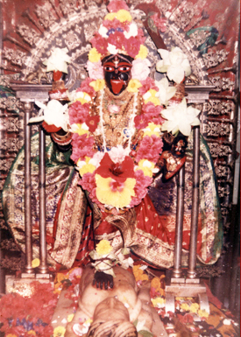
Dakshineswar Kali Temple (in Kolkatta)
Dakshineswar Kali Temple It is situated alongside the Vivekananda Bridge north of Kolkata, about 20 km. from BBD Bagh. It is famous for its association - with Ramkrishna who achieved spiritual vision here. Rani Rashmoni built this temple in 1847. The 12- spired temple with its enormous courtyard is surrounded by 12 other temples dedicated to Lord Shiva. It is a world famous place of pilgrimage. It was here the famous religious thinker Rama Krishna Paramahamsa achieved his spiritual vision and preached the unity of all religions.

Slide 28
Andhra Pradesh

Slide 29
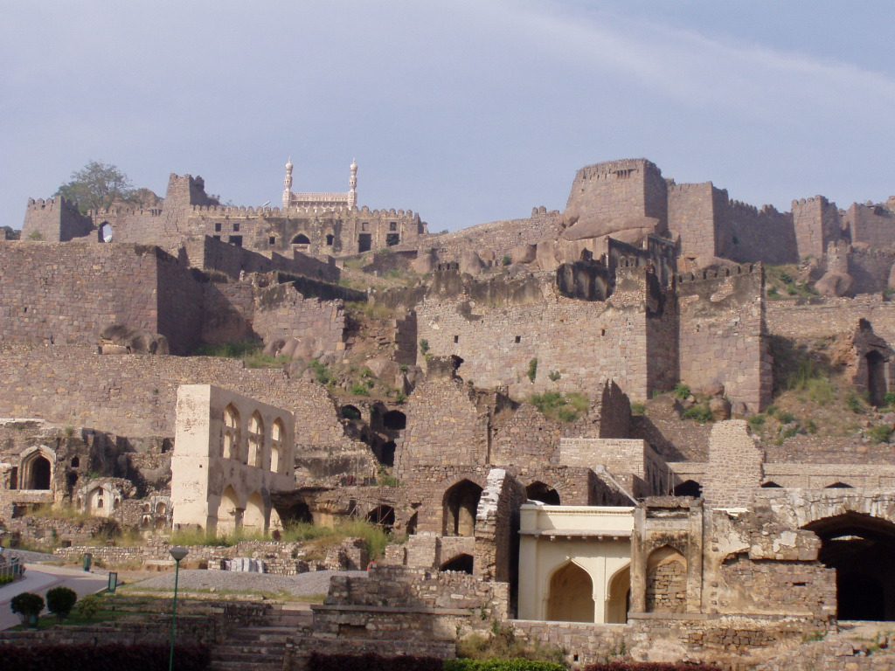
Golconda Fort (in Hyderabad)
Golconda is one of the famous forts of India. The name originates from the Telugu words "Golla Konda" meaning "Shepherd's Hill". The origins of the fort can be traced back to the Yadava dynasty of Deogiri, and the Kakatiyas of Warangal. Golconda was originally a mud fort, which passed to the Bahmani dynasty and later to the Qutb Shahis, who held it from 1518 to 1687 A.D. The first three Qutb Shahi kings rebuilt Golconda, over a span of 62 years. The fort is famous for its acoustics, palaces, factories, ingenious water supply system and the famous Fateh Rahben gun, one of the cannons used in the last siege of Golconda by Aurangzeb, to whom the fort ultimately fell.

Slide 30
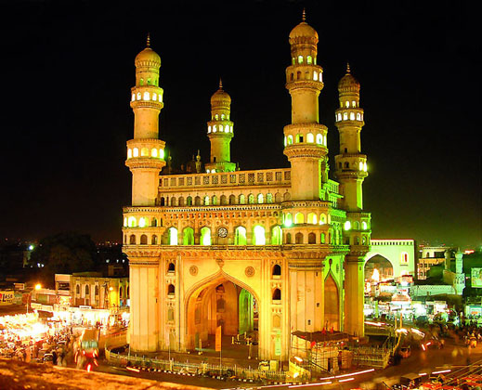
Charminar (in Hyderabad)
Charminar is as much the signature of Hyderabad as Taj Mahal is of Agra or Eiffel Tower is of Paris. Mohammed Quli Qutb Shah, the founder of Hyderabad, built Charminar in 1591 at the centre of the original city layout. It is believed to have been built as a charm to ward off a deadly epidemic raging at that time. Four graceful minarets soar to a height of 48.7m. Charminar has 45 prayer spaces and a mosque in it.

Slide 31
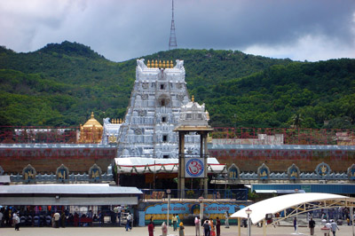
Lord Venkateswara Temple (in Tirupati)
Lord Venkateswara Temple Nestled among high Eastern Ghats, Tirumala can be reached only after covering the range of hills. The presiding deity Lord Venkateswara is also referred to as Lord of the Seven Hills. Patronized by Pallavas, Pandyas, Cholas, Vijayanagar kings and later by the king of Mysore, the temple finds a mention in the Sastras and Puranas. The main temple is a magnificent example of the fine Indian temple architecture. Both the Vimana over the sanctum sanctorum and the Dhwajasthambam (temple flag-post) are plated with gold.

Slide 32
Tamil Nadu

Slide 33
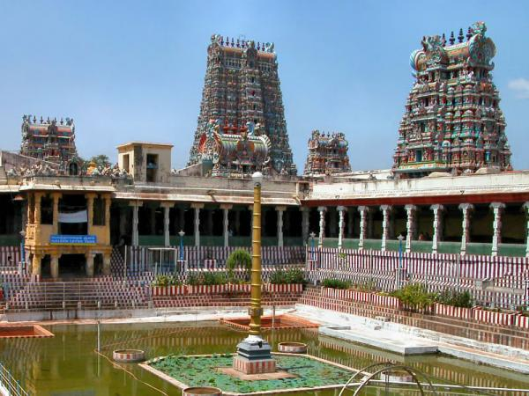
Meenakshi Temple-Madurai
MEENAKSHI TEMPLE - Located at the heart of the city, the Meenakshi- Sundareswarar temple has long been the focus of both Indian and international tourist attraction as well as one of the most important places of Hindu pilgrimage. For the people of Madurai, the temple is the very centre of their cultural and religious life. While the major festivals of Tamil Nadu are celebrated here with gaiety that equals the rest of the state, the most important moment in Madurai is the Chittirai festival that is held in April/May, when the celestial marriage of Meenakshi and Sundareswarar is celebrated, drawing a huge crowd of people from all over the state.This pre-Christian era temple was actually built by Kulasekara Pandya but it was in ruins before it was rebuilt by Tirumalai Nayak who brought back the glory to this magnificent structure. Of its 12 gopurams, four of the tallest stand at the outer walls of the temple. The 48.4m high southern gopuram is the most spectacular and has over 1500 sculptures. From its top, it is possible to obtain a panoramic view of the city. The Rajagopuram on the eastern side is an unfinished structure, which has a 174-sq.ft base, and had this tower been completed, it would surely have been the largest of its kind in the country. The eight smaller gopurams are within the compounds of the twin temples.

Slide 34
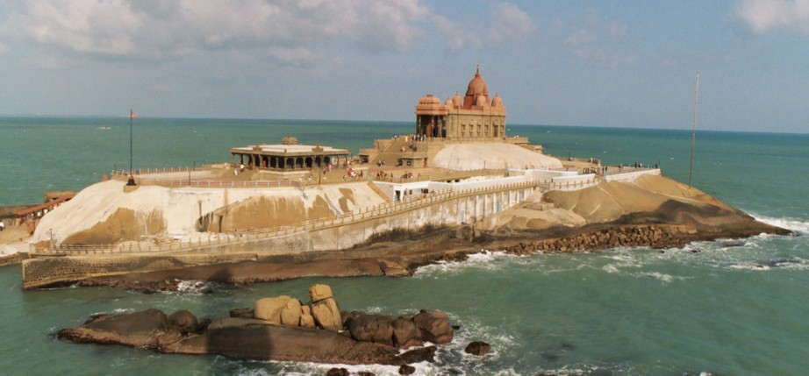
Vivekananda Memorial-Kanniyakumari
Vivekananda Memorial: The memorial has been built on the Vivekananda Rock where the great philosopher - guide Swami Vivekananda went into meditation that transformed him into one of the most charismatic spiritual leaders of this century. The unique, structure was built in 1970 and is a blend of various architectural styles of India. Close to the Vivekananda Rock is another rock called Sripada Parai meaning 'the rock that has been blessed by the touch of the feet of the goddess'. Both these rocks are fine places from where one can have a view of the land's end of India.

Slide 35
Karnataka

Slide 36
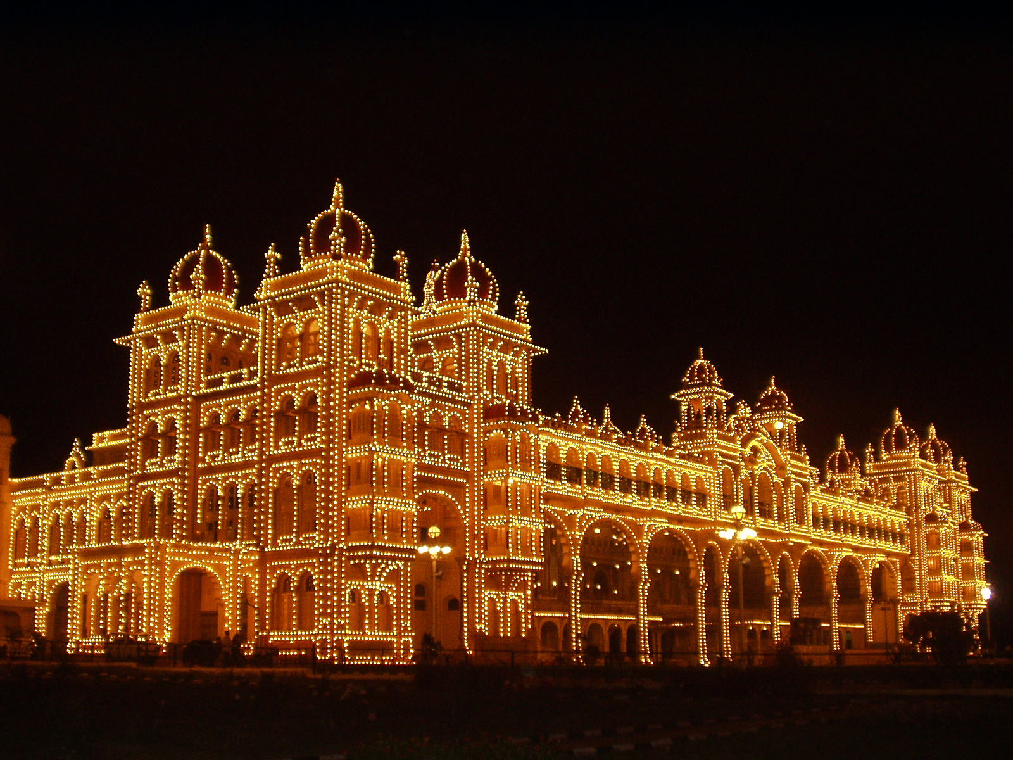
Maharaja Palace (in Mysore)
Maharaja's Palace - Designed by the English Architect, Henry Irwin, the Mysore Palace dominates the skyline of Mysore. A three storied structure in the Indo-Saracenic style built between 1897-1912, the palace has beautifully designed square towers at cardinal points, covered with domes. The Durbar Hall with its ornate ceiling and sculpted pillars and the Kalyanamantapa (Marriage Pavilion) with its glazed tiled flooring and stained glass, domed ceiling are worth noting. Intricately carved doors, the golden howdah (elephant seat), paintings as well as the fabulous, jewel encrusted golden throne (displayed during Dasara) are amongst the palace's other treasures. The walled palace complex houses the Residential Museum (incorporating some of the Palace's living quarters), temples and shrines including the Shwetha Varahaswamy temple. The palace is illuminated on Sundays, Public Holidays as well as during the Dasara Celebrations when 97,000 electric bulbs are used to illuminate it.

Slide 37
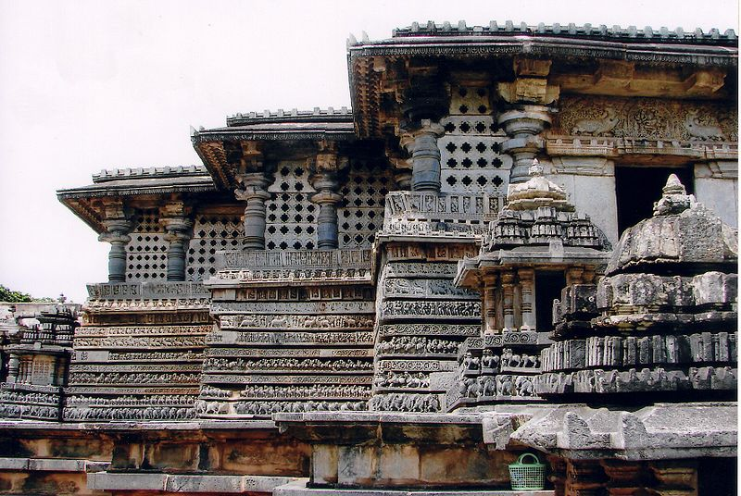
Hoysaleswar Temple, Halebid
The Hoysaleswara temple, dating back to the 1121 C.E., is astounding for its wealth of sculptural details. The walls of the temple are covered with an endless variety of depictions from Hindu mythology, animals, birds and Shilabalikas or dancing figures. Yet no two sculptures of the temple are the same. This magnificent temple guarded by a Nandi Bull was never completed, despite 86 years of labour. The Jain basadi nearby are equally rich in sculptural detail.

Slide 38
Kerala

Slide 39
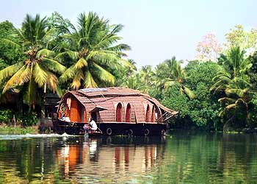
Kerala Backwaters
The Kerala backwaters are a chain of brackish lagoons and lakes lying parallel to the Arabian Sea coast (known as the Malabar Coast) of Kerala state in southern India. The network includes five large lakes linked by canals, both manmade and natural, fed by 38 rivers, and extending virtually half the length of Kerala state. The backwaters were formed by the action of waves and shore currents creating low barrier islands across the mouths of the many rivers flowing down from the Western Ghats range.
The Kerala Backwaters are a network of interconnected canals, rivers, lakes and inlets, a labyrinthine system formed by more than 900 km of waterways, and sometimes compared to the American Bayou. In the midst of this landscape there are a number of towns and cities, which serve as the starting and end points of backwater cruises

Slide 40
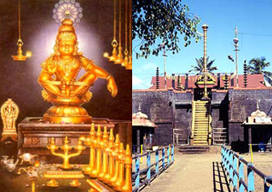
Sabarimala Ayyapan Swamy Temple
Sabarimala is a Hindu pilgrimage center located in the Western Ghat mountain ranges of Pathanamthitta District in Kerala. Sabarimala is believed to be the place where the Hindu God Ayyappan meditated after killing the powerful demoness, Mahishi. Ayyappan's temple is situated here amidst 18 hills. The temple is situated on a hilltop at an altitude of 468 m above mean sea level, and is surrounded by mountains and dense forests. Temples exist in each of the hills surrounding Sabarimala. While functional and intact temples exist at many places in the surrounding areas like Nilackal, Kalaketi, and Karimala, remnants of old temples survive to this day on remaining hills.
Sabarimala is linked to Hindu pilgrimage, predominantly for men of all ages; Ayyappan Devotees must go at least once in their lifetime and it is the largest annual pilgrimage in the world with an estimated 45–50 million devotees visiting every year.
The temple is open for worship only during the days of Mandalapooja (approximately November 15 to December 26), Makaravilakku (January 14- "Makara Sankranti") and Vishu (April 14), and the first six days of each Malayalam month.

